Slide 1
EE 382M Final Project:
Monolithic 3D IC Standard Cell Library
Emily Bragg, Tengchieh Huang
2014-12-08

Slide 2
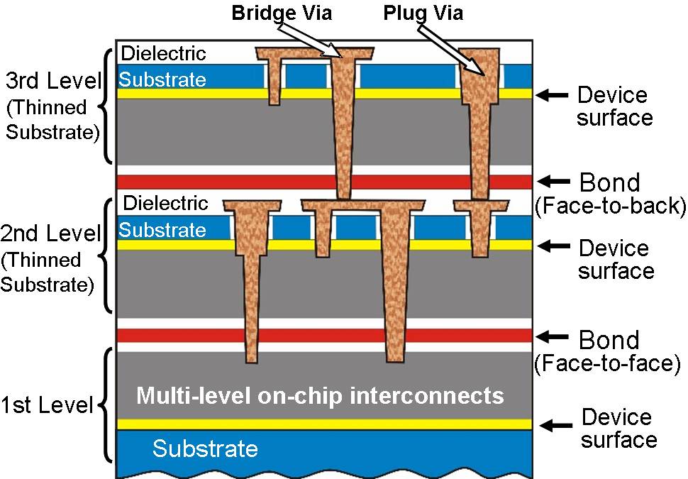
Technology Intro: 3D ICs
Stacking silicon layers
Introduces many complicated issues
Need connections
between layers
Difficult to design
TSVs
[image from http://www.process-evolution.com/3d-ics_doe.html]

Slide 3
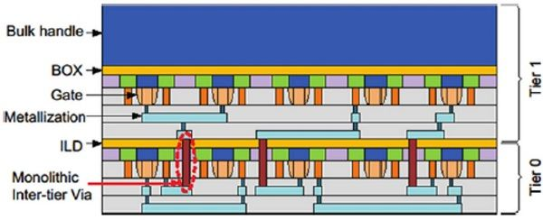
Monolithic?
No large TSVs
Monolithic Inter-tier Via -> 1% of TSV size (~70nm)
Builds layers up sequentially
[image from Qualcomm presentation, June 2014]

Slide 4
Motivations
Area
Potential gains of ~40%
Ease of Design
Doesn’t require awareness of TSVs to combine these cells

Slide 5
Design Process
Designed 2D and 3D versions of each cell
Used long wires to simulate the additional resistance of a MIV
Simulated and compared the two designs

Slide 6
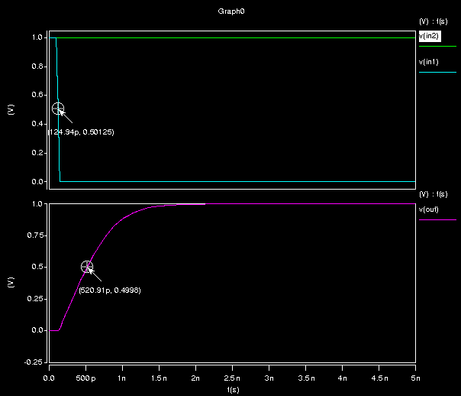
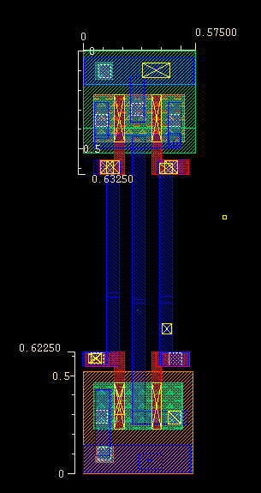
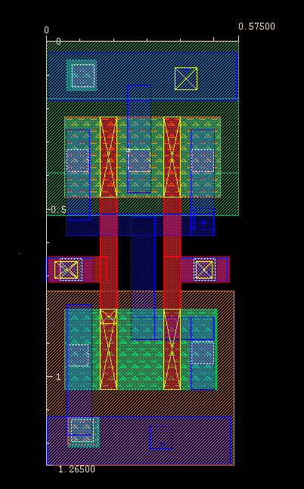
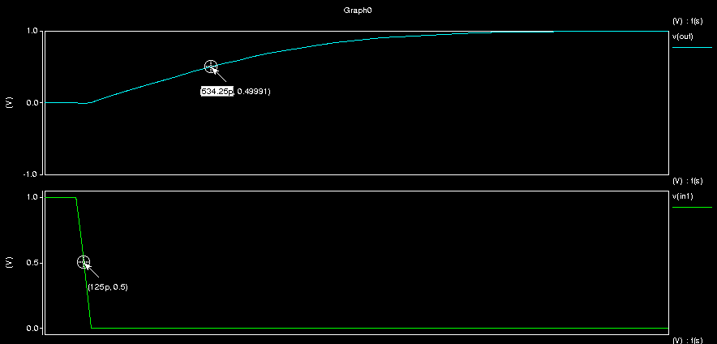
Rise Time: 520ps
Rise Time: 534ps
NAND2 Design Process

Slide 7
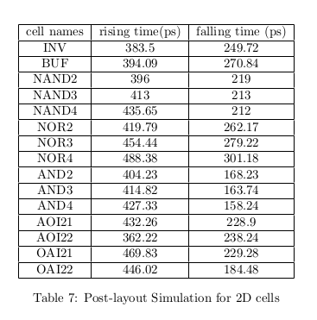
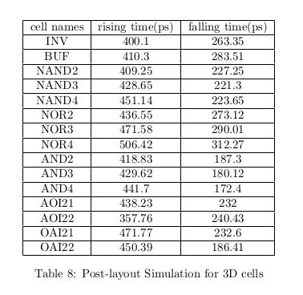
Timing Results

Slide 8
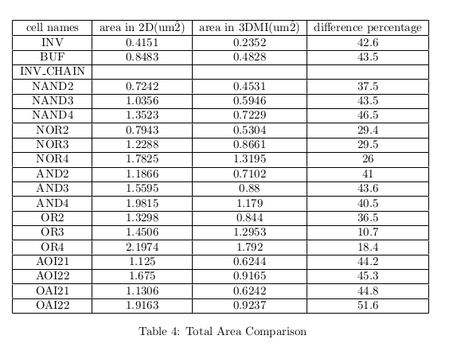
Area Results

Slide 9
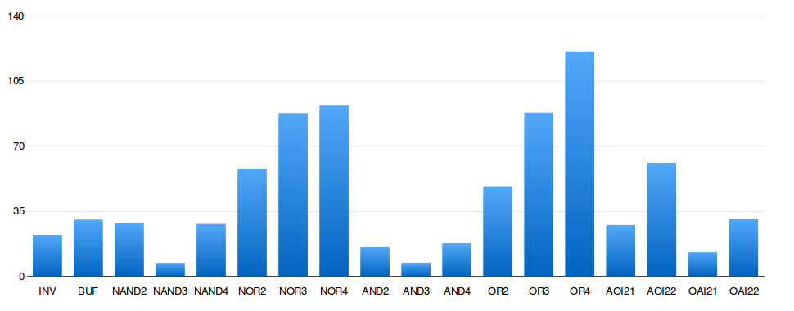
Comparison of Cells

Slide 10
Constraints
Software!
3D ICs are new technology
NCSU 45NM 3DPDK only supports TSV-based
Need more advanced tools to properly layout

Slide 11
Future Work
Software library that supports monolithic integration
Additional cells
Determine the average area improvement after routing overhead

Slide 12
Questions?

